Slide 1


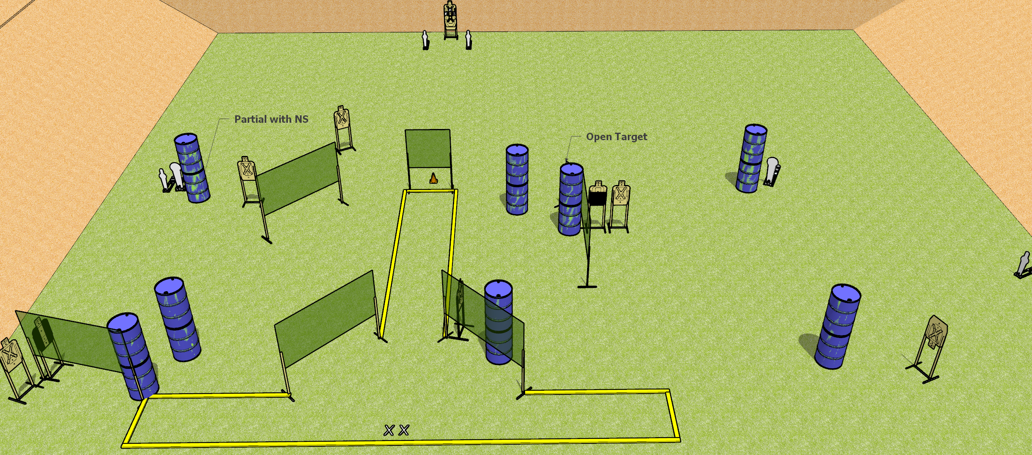
 | Dothan Gun Club – USPSA Match T-Route Course Designer : Patrick Free
START POSITION : Standing with both feet on X’s, wrists below belt
GUN READY CONDITION : Pistol unloaded and holstered, hammer down. PCC unloaded, shouldered, hammer down, pointed at orange cone. |  | SCORING: Comstock, 30 rounds TARGETS: 12 paper, 6 Steel SCORED HITS: Best 2 on paper, steel until down START-STOP: Audible, last shot RULES:
STAGE PROCEDURE: Engage targets as they become available from within the fault lines.

Slide 2
T-Route
Written Stage Briefing
T-Route is a 30 round, 150 point, Comstock Field Course. There are twelve USPSA targets, two Colt Poppers, and two mini poppers. The best two hits on paper will score and steel must fall to score. The start signal is audible.
Handgun start position is both feet on X’s, wrists below belt. Handgun is unloaded, hammer down, and holstered.
PCC start position is both on X’s. Unloaded carbine held with both hands, hammer down, shouldered, pointed at orange cone.
Upon start signal, engage targets as they become available from within the fault lines.

